Slide 1
Ellipsoidal Path Planning
7/20/2018

Slide 2
Status
Derived a generalized closed-form Minkowski sum/difference for ellipsoids
Finished implementing Highway RoadMap in C++
Implemented PRM in SE(2)/SE(3) for ellipsoidal robot
Benchmark algorithms: Highway RoadMap, PRM for different maps

Slide 3
Generalized Closed-form Minkowski Operations
Any N-d surface:
N-d ellipsoid:
Generalized Closed-form Minkowski Sum/Difference:
Where,

Slide 4
Explicitly for Superellipse
Then,

Slide 5
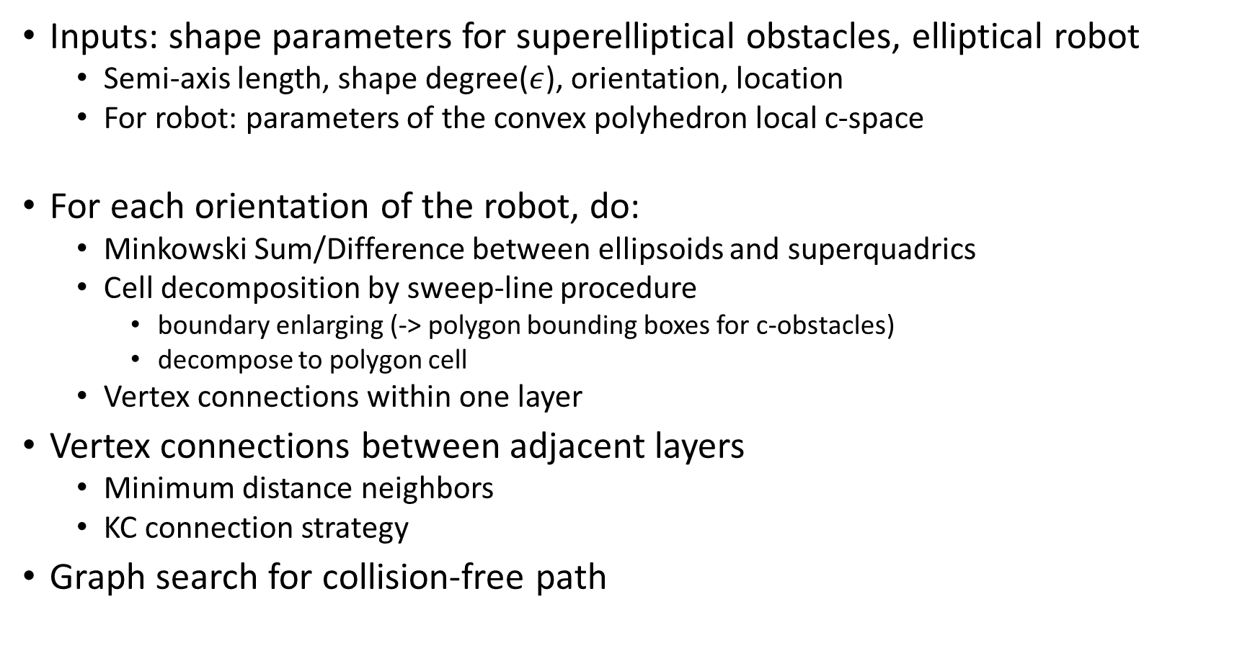
Implementations of Highway RoadMap for SE(2)
Inputs: shape parameters for superelliptical obstacles, elliptical robot
Semi-axis length, shape degree($ε$), orientation, location
For robot: parameters of the convex polyhedron local c-space
For each orientation of the robot, do:
Minkowski Sum/Difference between ellipsoids and superquadrics
Cell decomposition by sweep-line procedure
boundary enlarging (-> polygon bounding boxes for c-obstacles)
decompose to polygon cell
Vertex connections within one layer
Vertex connections between adjacent layers
Minimum distance neighbors
KC connection strategy
Graph search for collision-free path

Slide 6
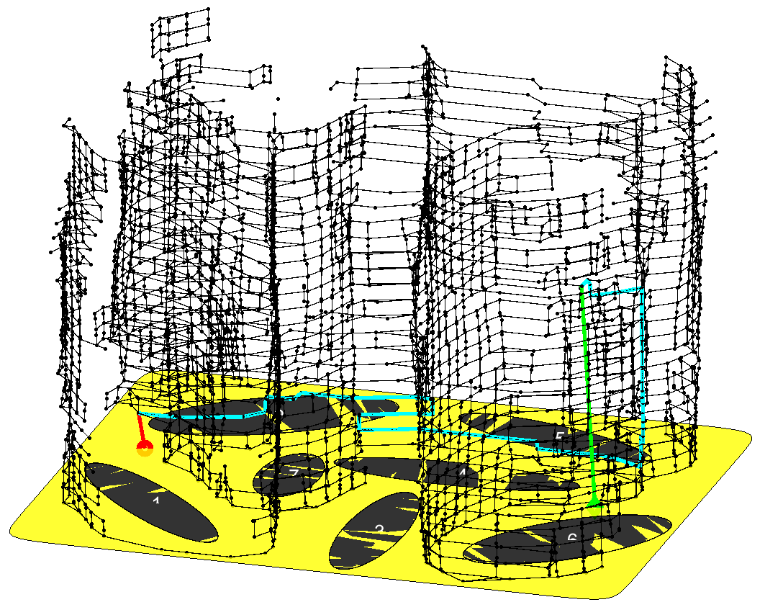
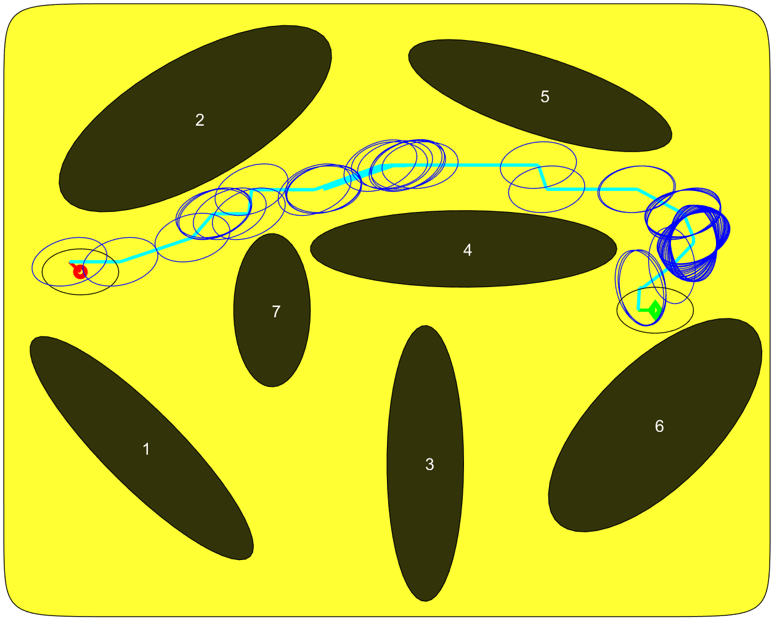
Result Visualizations
Vertex
Edge
Collision Free Path

Slide 7
PRM in SE(2)
Collision checking method:
For ellipse: Algebraic condition of separations
For superellipse: treat as polygon, define vertex and edge, call FCL

Slide 8
Benchmark
Defined different sparsity of the map:
Based on the relative area of the free space
Area of superellipse:
For simplicity, obstacles not overlap, all inside the arena, then

Slide 9
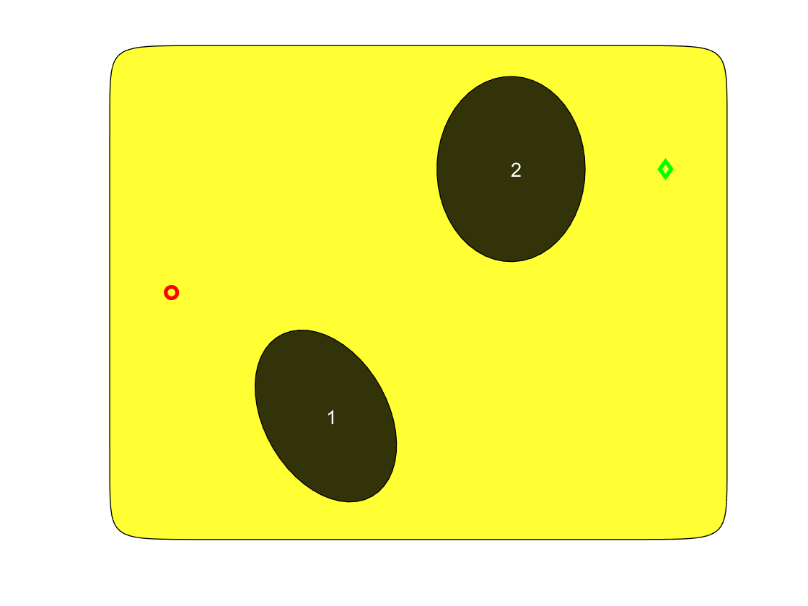
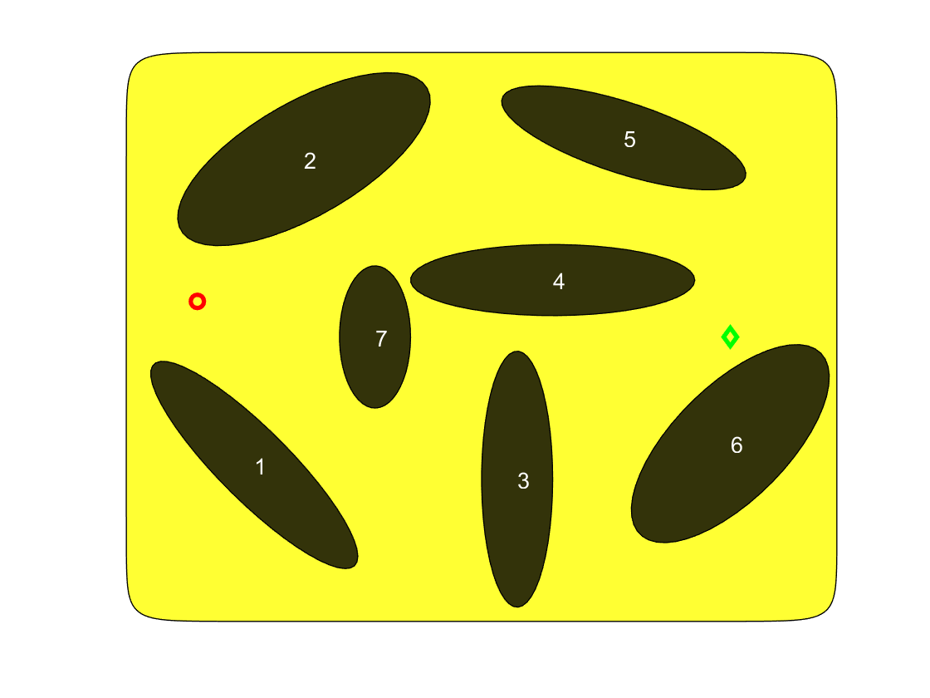
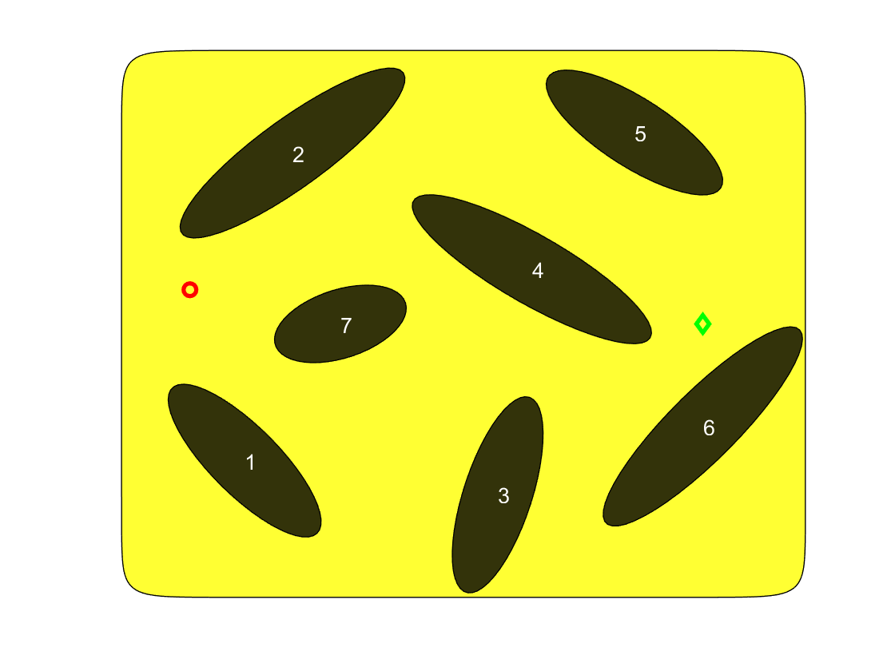
Benchmark Results (tentative)

Slide 10
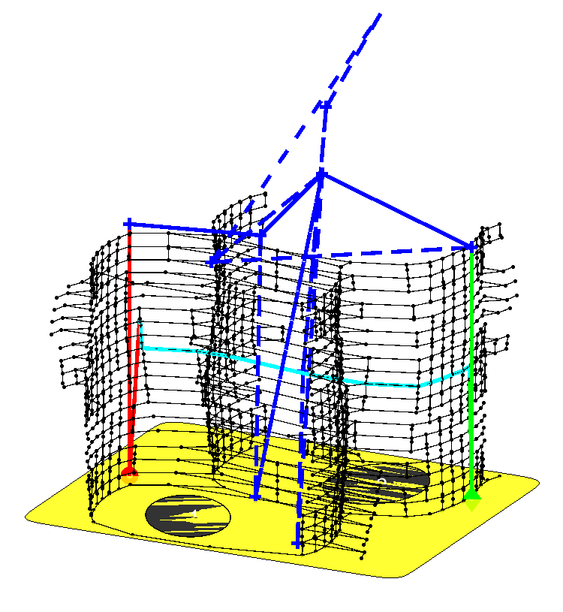
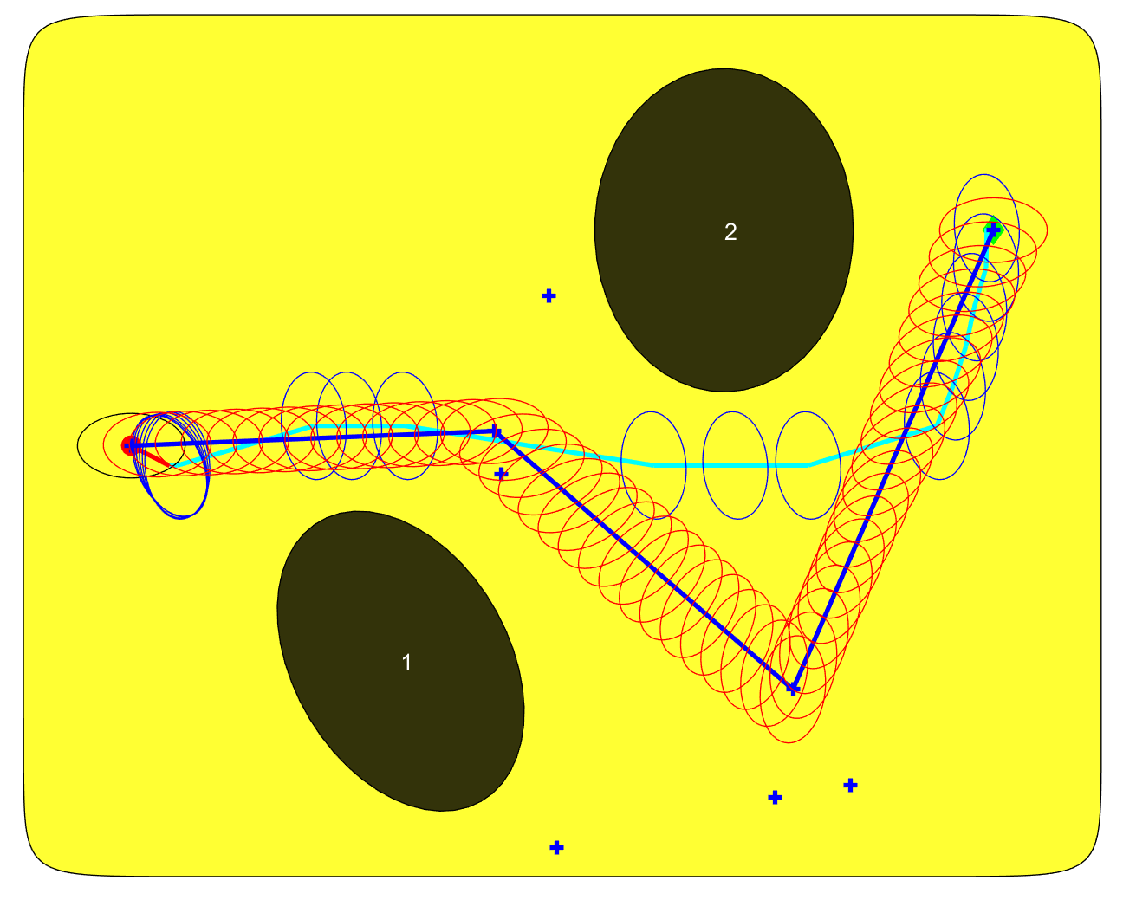
Visualizations
Highway RoadMap
Highway RoadMap
PRM
PRM

